Slide 1
A Gentle Introduction to SQL
ICOS Big Data Summer Camp
June 5th, 2017
Teddy DeWitt
(original slides from Mike Cafarella)

Slide 2
Learning Overview
Why is SQL cool?
Intro to schema and tables
Running queries
On-ramp for SQL – read MOAR books!
Data Boot Camp!

Slide 3
Relational Databases (1)
A database is an organized collection of data
A common kind is a relational database
The software is called a Relational Database Management System (RDBMS)
  Oracle, PostgreSQL, Microsoft’s SQLServer, MySQL, SQLite, etc
Your dataset is “a database”, managed by an RDBMS
AID | Name | Country | Sport
1 | Mary Lou Retton | USA | Gymnastics
2 | Jackie Joyner-Kersee | USA | Track
3 | Michael Phelps | USA | Swimming
Notes:
There are non-relational databases like NoSQL, Mongo DB, CouchDB

Slide 4
Relational Databases (2)
A relational database is a set of “relations” (aka tables)
Each relation has two parts:
  Instance (a data table, with rows (aka tuples, records), and columns (aka fields, attributes))
    # Rows = cardinality
    # Columns = degree
  Schema
    Relation name
    Name and type for each column
    E.g., Student (sid int, name varchar(128))
Excel comparison?
  Instances or Tables are like tabs
  Schema is column headers and format cells (e.g., number, date, text)

Slide 5
Instance of Athlete Relation
AID | Name | Country | Sport
1 | Mary Lou Retton | USA | Gymnastics
2 | Jackie Joyner-Kersee | USA | Track
3 | Michael Phelps | USA | Swimming
What is the schema?
(aid: integer, name: string, country: string, sport:string)
Cardinality & Degree?
Cardinality = 3, Degree = 4
Notes:
A string is a set of characters usually a mixture of letters, numbers and other symbols

Slide 6
Relational Query Languages
An RDBMS does lots of things, but mainly:
  Keeps data safe
  Gives you a powerful query language
RDBMS is responsible for efficient evaluation
  System can optimize for efficient query execution, and still ensure that the answer does not change
Most popular query language is SQL
Notes:
9
It is a non-procedural language
A procedural language defines both the desired results and the mechanism,
or process, by which the results are generated. Nonprocedural
languages also define the desired results, but the process by which the
results are generated is left to an external agent.
Declarative is very black box. You kind of say what you want and the system figures out the best way to get the information. A language like C is going to

Slide 7
Let’s make this table - Athlete
AID | Name | Country | Sport
1 | Mary Lou Retton | USA | Gymnastics
2 | Jackie Joyner-Kersee | USA | Track
3 | Michael Phelps | USA | Swimming

Slide 8
Creating Relations in SQL
Create the Athlete relation (table)
CREATE TABLE Athlete
(aid INTEGER,
name CHAR(30),
country CHAR(20),
sport CHAR(20))
AID | Name | Country | Sport
Notes:
This assumes we have already created an empty database. This is actually trivial in SQLite and PostgreSQL

Slide 9
Adding & Deleting Rows in SQL
INSERT INTO Athlete (aid, name, country, sport)
VALUES (1, ‘Mary Lou Retton’, ‘USA’, ‘Gymnastics’)
INSERT INTO Athlete (aid, name, country, sport)
VALUES (2, ‘Jackie Joyner-Kersee’, ‘USA’, ‘Track’)
INSERT INTO Athlete (aid, name, country, sport)
VALUES (3, ‘Michael Phelps’, ‘USA’, ‘Swimming’)
And we are going to add another row!
INSERT INTO Athlete (aid, name, country, sport)
VALUES (4, ‘Johann Koss’, ‘Norway’, ‘Speedskating’)
Notes:
10

Slide 10
Table. Athlete. Boom!
AID | Name | Country | Sport
1 | Mary Lou Retton | USA | Gymnastics
2 | Jackie Joyner-Kersee | USA | Track
3 | Michael Phelps | USA | Swimming
4 | Johann Koss | Norway | Speedskating
Notes:
I know that I have talked about SQL DBs maybe having a million rows of data and our’s has 4. But the thing is that it is easy to memorize this DB and run queries in our heads.

Slide 11
Getting Data in SQL (1)
SELECT all of the rows and columns:
SELECT *
FROM Athlete
AID | Name | Country | Sport
1 | Mary Lou Retton | USA | Gymnastics
2 | Jackie Joyner-Kersee | USA | Track
3 | Michael Phelps | USA | Swimming
4 | Johann Koss | Norway | Speedskating
Only names and sports:
SELECT name, sport
FROM Athlete
Name | Sport
Mary Lou Retton | Gymnastics
Jackie Joyner-Kersee | Track
Michael Phelps | Swimming
Johann Koss | Speedskating
SELECT A.name, A.sport
FROM Athlete A
Notes:
Make sure you tell them about aliasing
Make sure you tell them about unique rows
Make sure you say that it is good form to do this practice always name your tables

Slide 12
Getting Data in SQL (2)
AID | Name | Country | Sport
1 | Mary Lou Retton | USA | Gymnastics
2 | Jackie Joyner-Kersee | USA | Track
3 | Michael Phelps | USA | Swimming
4 | Johann Koss | Norway | Speedskating
SELECT names and sports WHERE country is USA:
SELECT A.name, A.sport
FROM Athlete A
WHERE A.country = ‘USA’
Name | Sport
Mary Lou Retton | Gymnastics
Jackie Joyner-Kersee | Track
Michael Phelps | Swimming

Slide 13
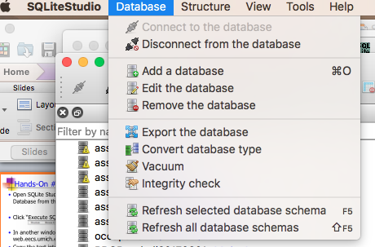
Hands-On #1
Open SQLite Studio and Select “Add a Database from the Database Menu”
Data Boot Camp!
Notes:
Positions #s
Schema:
playerID, year, gameNum, gameID, teamID, lgID, GP, startingPos
('ortizda01', 2012, 0, 'ALS201207100', 'BOS', 'AL', 1, 0),

Slide 14
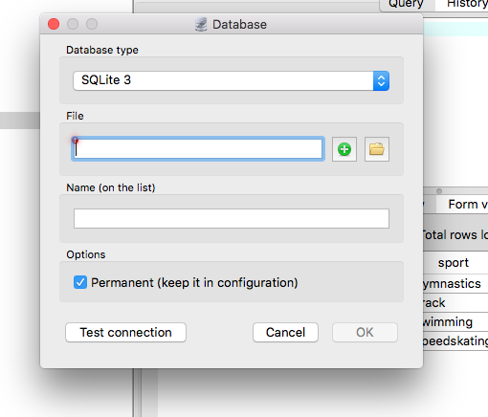
Hands-On #1
Click the green plus button to add a new file
Data Boot Camp!
Notes:
Positions #s
Schema:
playerID, year, gameNum, gameID, teamID, lgID, GP, startingPos
('ortizda01', 2012, 0, 'ALS201207100', 'BOS', 'AL', 1, 0),

Slide 15
Hands-On #1
Name it something appropriate like DB_test and save it to a folder where you can find it.
Data Boot Camp!
Notes:
Positions #s
Schema:
playerID, year, gameNum, gameID, teamID, lgID, GP, startingPos
('ortizda01', 2012, 0, 'ALS201207100', 'BOS', 'AL', 1, 0),

Slide 16
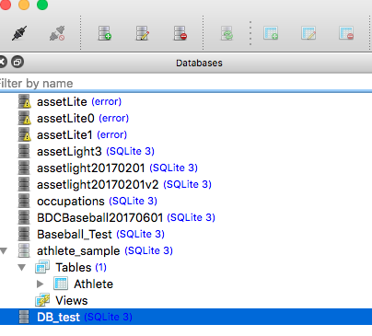
Hands-On #1
Select/highlight your DB File in the right hand window and click Connect to database
Data Boot Camp!
Notes:
Positions #s
Schema:
playerID, year, gameNum, gameID, teamID, lgID, GP, startingPos
('ortizda01', 2012, 0, 'ALS201207100', 'BOS', 'AL', 1, 0),

Slide 17
Hands-On #1
In another window, go to web.eecs.umich.edu/~michjc/teams.txt
Highlight all of the text you see and copy it to your clipboard.
Data Boot Camp!
Notes:
Positions #s
Schema:
playerID, year, gameNum, gameID, teamID, lgID, GP, startingPos
('ortizda01', 2012, 0, 'ALS201207100', 'BOS', 'AL', 1, 0),

Slide 18
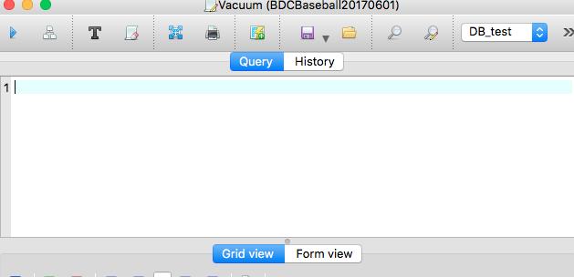
Hands-On #1
Paste all of the text in the query window, highlight all of the text and then click the “play” button.
Data Boot Camp!
Notes:
Positions #s
Schema:
playerID, year, gameNum, gameID, teamID, lgID, GP, startingPos
('ortizda01', 2012, 0, 'ALS201207100', 'BOS', 'AL', 1, 0),

Slide 19
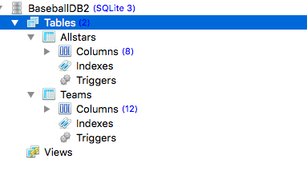
Hands-On #1
If all has gone according to plan you should have a databse in the left hand pane with two tables
Data Boot Camp!
Notes:
Positions #s
Schema:
playerID, year, gameNum, gameID, teamID, lgID, GP, startingPos
('ortizda01', 2012, 0, 'ALS201207100', 'BOS', 'AL', 1, 0),

Slide 20
Hands-On #1
Write queries to find:
  Names of all the players in the database
  All info for all players from Detroit
  Names and teams of the first basemen (Position ID: 3)
Data Boot Camp!

Slide 21
Basic SQL Query
Attributes from input relations
Optional
List of relations
SELECT [DISTINCT] attr-list
FROM relation-list
WHERE qualification
Attr1 op Attr2
OPS: <, >, =, <=, >=, <>
Combine using AND, OR, NOT
(Conceptual) Evaluation:
1. Take cross-product of relation-list
2. Select rows satisfying qualification
3. Project columns in attr-list
(eliminate duplicates only if DISTINCT)
Notes:
This is the basic structure. We did some very basic query selection, but now we are going to get more fancy

Slide 22

Example of Basic Query(1)
Schema:
  Sailors (sid, sname, rating, age)
  Boats (bid, bname, color)
  Reserves (sid, bid, day)

Slide 23
Example of Basic Query(2)
Boats
Sailors
bid | bname | color
101 | jeff | red
103 | boaty | black
sid | sname | rating | age
22 | dustin | 7 | 45
58 | rusty | 10 | 35
31 | lubber | 8 | 55
Reserves
sid | bid | day
22 | 101 | Oct-10
58 | 103 | Nov-12
58 | 103 | Dec-13

Slide 24
Example of Basic Query(3)
Schema:
  Sailors (sid, sname, rating, age)
  Boats (bid, bname, color)
  Reserves (sid, bid, day)
Find the names of sailors who have reserved boat #103
Are the names of the sailors and the numbers of the boats reserved in the same place?
Must JOIN the Sailors and Reserve tables

Slide 25

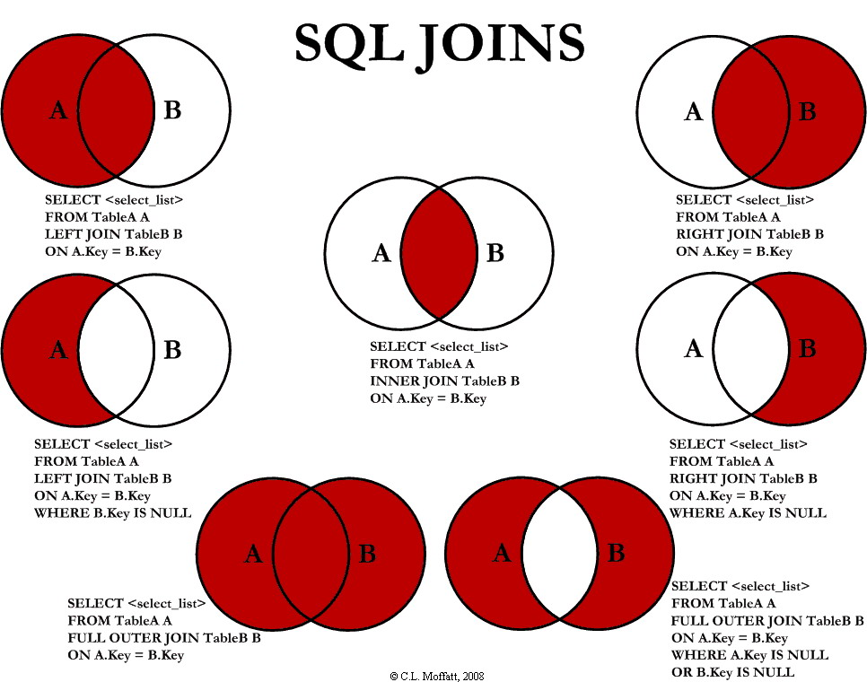
JOINS Overview
Notes:
The joins can be kind of confusing. Joins and really all of database stuff is grounded in relational algebra. But frankly we don’t have time for that and you don’t need to know relational algebra to be able to do SQL. Just remember these diagrams and look at sample queries underneath. What we will do here is explore one of the join versions that we will use to link the sailors and reserves tables - INNER JOIN

Slide 26
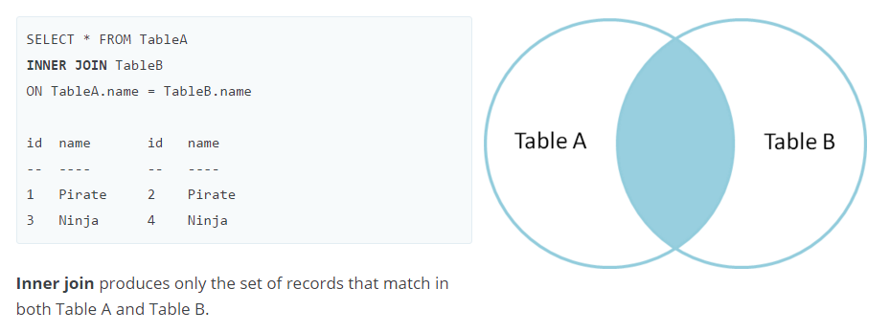
JOINS Overview
INNER JOIN
Inner join produces only the set of records that match in both Table A and Table B.
Sailors
Reserves
sid | sname | rating | age
22 | dustin | 7 | 45
58 | rusty | 10 | 35
31 | lubber | 8 | 55
sid | bid | day
22 | 101 | Oct-10
58 | 103 | Nov-12
58 | 103 | Dec-13

Slide 27
JOINS Overview
Sailors
Reserves
sid | sname | rating | age
22 | dustin | 7 | 45
58 | rusty | 10 | 35
31 | lubber | 8 | 55
sid | bid | day
22 | 101 | Oct-10
58 | 103 | Nov-12
58 | 103 | Dec-13
OUR GOAL - Find the names of sailors who have reserved boat #103.
SELECT S.sname FROM Sailors S JOIN Reserves R on S.sid=R.sid WHERE R.bid=103

Slide 28
JOINS Overview
What the query does, more or less
Sailors S JOIN Reserves R on S.sid=R.sid
S.sid | S.sname | S.rating | S.age | R.sid | R.bid | R.day
22 | dustin | 7 | 45 | 22 | 101 | Oct-10
58 | rusty | 10 | 35 | 58 | 103 | Nov-12
58 | rusty | 10 | 35 | 58 | 103 | Dec-13
WHERE R.bid=103
S.sid | S.sname | S.rating | S.age | R.sid | R.bid | R.day
22 | dustin | 7 | 45 | 22 | 101 | Oct-10
58 | rusty | 10 | 35 | 58 | 103 | Nov-12
58 | rusty | 10 | 35 | 58 | 103 | Dec-13

Slide 29
Example of Basic Query(4)
Find the names of sailors who have reserved boat #103
SELECT S.sname
FROM Sailors S JOIN Reserves R ON S.sid R.sid WHERE R.bid = 103
R.sname
rusty
rusty
UM, why do we get it twice??!

Slide 30
Using DISTINCT
3. Project columns in attr-list
(eliminate duplicates only if DISTINCT)
SELECT DISTINCT S.sname
FROM Sailors S JOIN Reserves R
ON S.sid = R.sid WHERE R.bid = 103
What’s the effect of adding DISTINCT?
sname
rusty

Slide 31
Hands-On #2
Go back to our baseball DB
Write queries to find:
  Team names for all teams with attendance more than 2,000,000
  Player ID and home stadium for all Allstars
  TeamID, attendance for teams that had an all-star player
Data Boot Camp!

Slide 32
ORDER BY clause
Most of the time, results are unordered
You can sort them with the ORDER BY clause
Attribute(s) in ORDER BY clause must be in SELECT list.
Find the names and ages of all sailors, in increasing order of age
Find the names and ages of all sailors, in decreasing order of age
SELECT S.sname, S.age
FROM Sailors S
ORDER BY S.age [ASC]
SELECT S.sname, S.age
FROM Sailors S
ORDER BY S.age DESC

Slide 33
ORDER BY clause
SELECT S.sname, S.age, S.rating
FROM Sailors S
WHERE S.age > 20
ORDER BY S.age ASC, S.rating DESC
What does this query compute?
Find the names, ages, & ratings of sailors over the age of 20.
Sort the result in increasing order of age.
If there is a tie, sort those tuples in decreasing order of rating.

Slide 34
Hands-On #3
Use the database loaded last time
A twist:
  Find TeamID and attendance values for teams that had an all-star player ORDERED BY ATTENDANCE
Data Boot Camp!

Slide 35
Aggregate Operators
COUNT (*)
COUNT ( [DISTINCT] A)
SUM ( [DISTINCT] A)
AVG ( [DISTINCT] A)
MAX (A) Can use Distinct
MIN (A) Can use Distinct
SELECT COUNT (*) FROM Sailors S
SELECT COUNT (DISTINCT S.name)
FROM Sailors S
single column
SELECT AVG (S.age)
FROM Sailors S
WHERE S.rating=10
SELECT AVG ( DISTINCT S.age)
FROM Sailors S
WHERE S.rating=10
Notes:
So we have been talking about how to pull just lines of data. But we may want to do more than that, and here are some of things that we can do. They are called aggregate functions

Slide 36
Hands-On #4
Use our DB
Find:
  Average attendance for all teams
  Average attendance among teams that had an all-star player
Data Boot Camp!

Slide 37
GROUP BY
Conceptual evaluation
  Partition data into groups according to some criterion
  Evaluate the aggregate for each group
Example: For each rating level, find the age of the youngest sailor
SELECT MIN (S.age), S.rating
FROM Sailors S
GROUP BY S.rating
How many tuples in the result?
Excel Equivalent: Think about the results you would want from a pivot table….

Slide 38
Hands-On #5
With our Baseball DB, first try a simple one:
  Show all teamIds that had an all-star, along with number of all-star players
Data Boot Camp!

Slide 39
Hands-On #5
Show all teamIds that had an all-star, along with number of all-star players
SELECT A.teamID, COUNT(*)
FROM Allstars A
GROUP BY teamID
Data Boot Camp!

Slide 40
Hands-On #5
Harder:
  Show all team names that had an all-star, along with number of all-star players
Data Boot Camp!

Slide 41
Hands-On #5
Even Harder:
  Show all team names that had an all-star, along with number of all-star players,
  SORTED IN DESCENDING ORDER BY NUMBER OF ALL-STARS
Data Boot Camp!

Slide 42
NULL Values in SQL
NULL represents ‘unknown’ or ‘inapplicable’
WHERE clause eliminates rows that don’t evaluate to true
What does this query return?
SELECT sname
FROM sailors
WHERE age > 45
OR age <= 45
sailors
sid | sname | rating | age
22 | dustin | 7 | 45
58 | rusty | 10 | NULL
31 | lubber | 8 | 55
Yes, it returns just dustin and lubber!
Notes:
If you wanted to find it you would have to say WHERE age IS NULL.

Slide 43
NULL Values in Aggregates
NULL values generally ignored when computing aggregates
sailors
SELECT AVG(age)
FROM sailors
sid | sname | rating | age
22 | dustin | 7 | 45
58 | rusty | 10 | NULL
31 | lubber | 8 | 55
Returns 50!

Slide 44
Questions?
Data Boot Camp!

Slide 45
Useful Resoruces
URLS
  http://www.w3schools.com/sql/
  http://www.tutorialspoint.com/sqlite/
  http://www.tutorialspoint.com/sqlite/sqlite_python.htm
Books
  Learning SQL – Alan Beaulieu
Online Courses
  Udemy – The Complete SQL Bootcamp ($)
Data Boot Camp!

Slide 46
APPENDIX
EECS 484

Slide 47
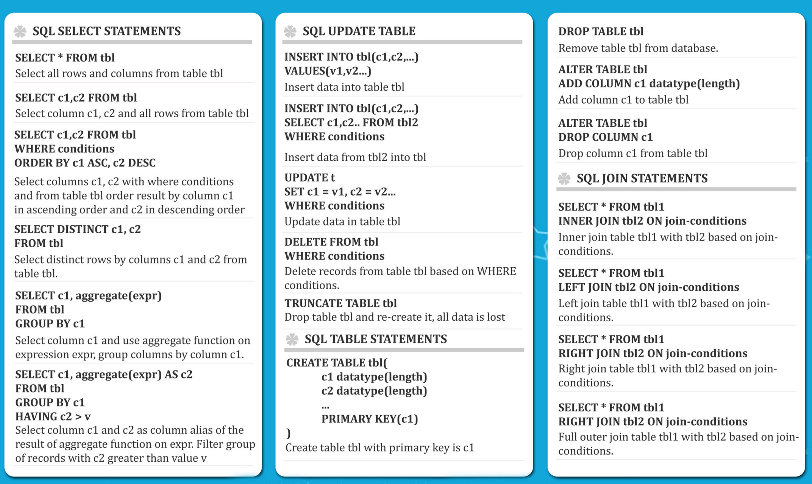
Data Boot Camp!

Slide 48
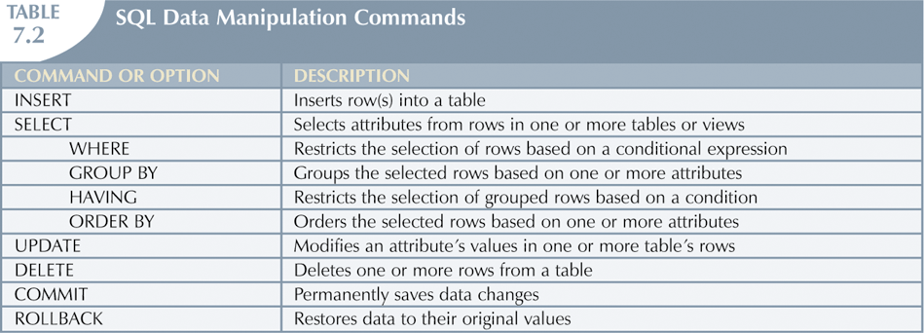
Data Boot Camp!

Slide 49
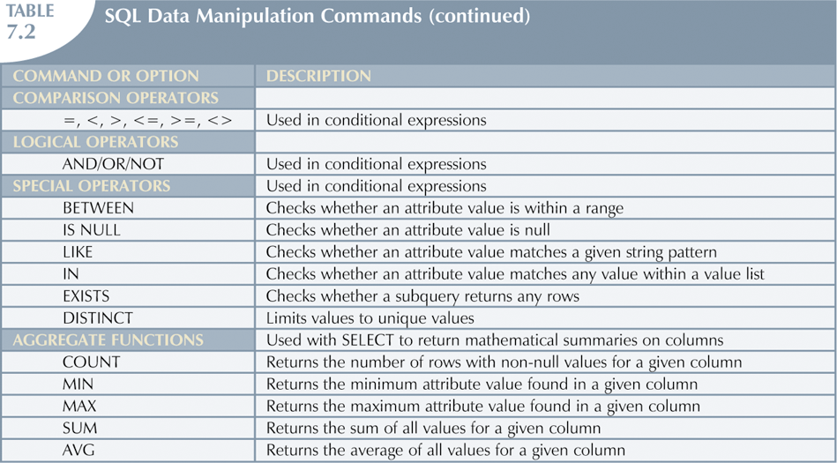
Data Boot Camp!

Slide 50
Useful Resoruces
URLS
  http://www.w3schools.com/sql/
  http://www.tutorialspoint.com/sqlite/
  http://www.tutorialspoint.com/sqlite/sqlite_python.htm
Books
  Learning SQL – Alan Beaulieu
Online Courses
  Udemy – The Complete SQL Bootcamp ($)
Data Boot Camp!

